Slide 1
Couchbase Data Pipeline
Stream your Operational Data w/ Apache Spark & Kafka into Hadoop using Couchbase

Slide 2
Agenda
Couchbase Overview
Couchbase Data Pipeline
Kafka
Demo - https://github.com/couchbase/couchbase-kafka-connector
Spark
Demo - https://github.com/justinmichaels006/CouchbaseSpark
Q&A

Slide 3
















Couchbase Overview
Couchbase is the company behind Couchbase Server & Couchbase Mobile
Open source JSON database
Founded 2010
400+ enterprise customers globally
Some of our customers:
Couchbase Server can be deployed as:
Document database
Key-value store
Distributed cache

Slide 4
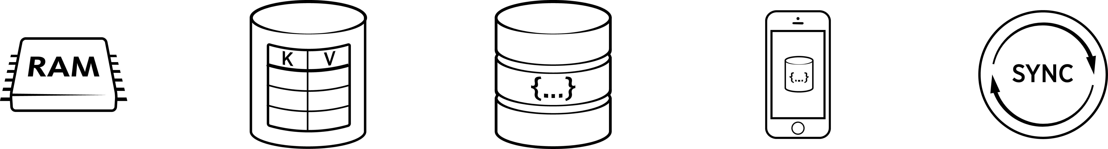
Couchbase Overview
The first NoSQL database that enables you to develop with agility and operate at any scale.
Managed Cache
Key-Value Store
Document Database
Embedded Database
Sync Management
Notes:
KEY POINT: COUCHBASE HAS YOU COVERED FOR YOUR GENERAL PURPOSE DB NEEDS. FROM CACHING TO KV STORE, TO JSON DOCUMENT STORE, TO MOBILE APPS. NO OTHER NOSQL DB VENDOR HAS THIS BREADTH AND DEPTH OF TECHNOLOGY
The purpose of this slide is to discuss the high level concepts of Couchbase, and if the SE wants to discuss what parts of Couchbase make up each concept. It is not to go over specific technologies like N1QL, ODBC, etc

Slide 5
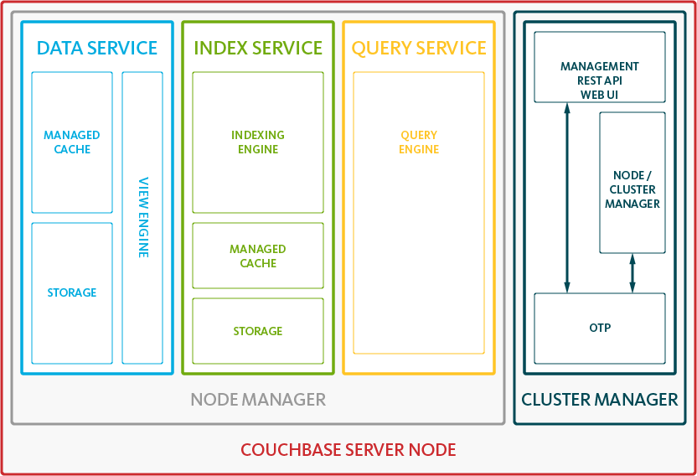
Couchbase Architecture
Data Service – builds and maintains Distributed secondary indexes (MapReduce Views)
Indexing Engine – builds and maintains Global Secondary Indexes
Query Engine – plans, coordinates, and executes queries against either Global or Distributed indexes
Cluster Manager – configuration, heartbeat, statistics, RESTful Management interface
Notes:
KEY POINT:
Frame the conversation

Slide 6
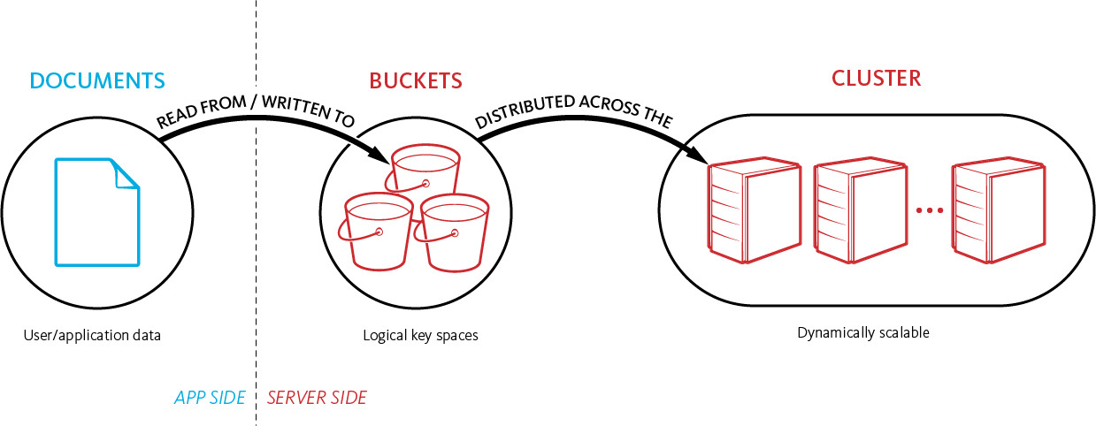
Storing And Retrieving Documents
Notes:
KEY POINT: GROUND THE USER IN HOW OBJECTs RELATE TO BUCKETS AND THOSE ARE SPREAD ACROSS THE CLUSTER; AS WELL AS HOW THINGS IN THE CLUSTER ARE STACKED PHYSICALLY.
Talk to the audience about how documents move in the application at a high level and the relation between data buckets and how they are spread evenly across the cluster.
Remember that vBuckets are not in this diagram, but that is on purpose. That comes later and might confuse people at this point. Going over this slide now sets you up for the vBucket discussion later in the presentation.
Convey what a bucket is. That it is a logical key space, with its own set of server resources, queues, etc.
Make sure to stress that one can have multiple buckets, but to not just create them like you would tables or schemas in a relational database
An example of when to split data into different buckets is using Views across different object types. For example, if you have JSON documents and base64 encoded XML documents in the same bucket, a view or index will have to interact with that object even though it will never need it. So it would be better to put the XML into another bucket so the views and indexes are only looking at the JSON data they actually will be indexing.

Slide 7
Online Linear Scalability
READ/WRITE/UPDATE
ACTIVE
ACTIVE
ACTIVE
ACTIVE
ACTIVE
SHARD
5
SHARD
2
SHARD
9
SHARD
4
SHARD
7
SHARD
8
SHARD
1
SHARD
3
SHARD
6
SHARD
SHARD
SHARD
SHARD
SHARD
SHARD
SHARD
SHARD
SHARD
REPLICA
REPLICA
REPLICA
REPLICA
REPLICA
SHARD
4
SHARD
1
SHARD
8
SHARD
6
SHARD
3
SHARD
2
SHARD
7
SHARD
9
SHARD
5
SHARD
SHARD
SHARD
SHARD
SHARD
SHARD
SHARD
SHARD
SHARD
Couchbase Server 1
Couchbase Server 2
Couchbase Server 3
Couchbase Server 4
Couchbase Server 5
Notes:
Application has single logical connection to cluster (client object)
Multiple nodes added or removed at once
One-click operation
Incremental movement of active and replica vbuckets and data
Client library updated via cluster map
Fully online operation, no downtime or loss of performance

Slide 8
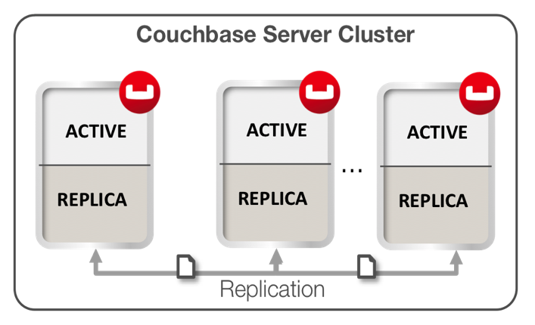
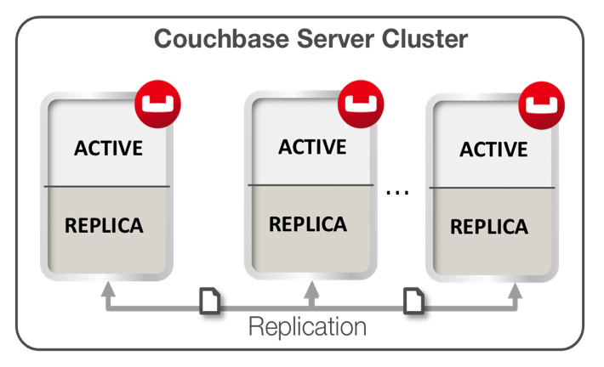
Cross Datacenter Replication (XDCR)
Unidirectional or Bidirectional Replication
Unidirectional
Hot spare / Disaster Recovery
Development/Testing copies
Connectors (Solr, Elasticsearch)
Integrate to custom consumer
Bidirectional
Multiple Active Masters
Disaster Recovery
Datacenter Locality

Slide 9
Couchbase Data Pipeline

Slide 10
DCP
Database Change Protocol
Since Couchbase Server 3.x internal standard to handle changes
Clients: Intra-Cluster Replication, Indexing, XDCR
Mutation
Event which is raised in case of a creation, update or delete
Each mutation that occurs in a vBucket has a sequence number
Core of the 2.x Java SDK
Can consume DCP streams
Important: API not yet exposed but used to implement Connectors provided by Couchbase

Slide 11
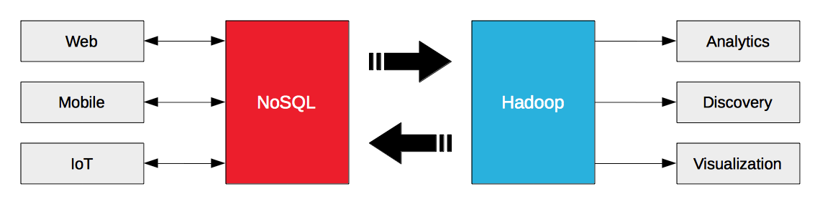
Couchbase Data Pipeline
Couchbase is primarily online operational NoSQL datastore, low latency, scalable
Data Source
Example: Pulling user profiles into Hadoop for deep analytics
Data Sink
Example: training machine learning models that are then cached / served from Couchbase
Web
NoSQL
Spark
Hadoop
Analytics
Mobile
Discovery
IoT
Prediction

Slide 12





Couchbase Data Pipeline
 | Couchbase | Spark | Hadoop (Hive)
Use cases | Operational Web / Mobile | Analytics Machine Learning | Analytics Machine Learning
Processing mode | Online Ad Hoc | Ad Hoc Batch Streaming (+/-) | Batch Ad Hoc (+/-)
Low latency = | < 1ms ops | Seconds | Minutes
Performance | Highly predictable | Variable | Variable
Users are typically… | Millions of customers | 100’s of analysts or data scientists | 100’s of analysts or data scientists
 | Memory-centric | Memory-centric | Disk-centric
Big data = | 10s of Terabytes | Petabytes (?) | Petabytes
OPERATIONAL
ANALYTICAL
Notes:
Use cases are totally different – Spark is an execution engine, not a database.
A prime use case for Hadoop is as a low cost data warehouse, which is not a good use case for Couchbase or Spark
Latency - Everyone says real time, but what do mean?
For an operational system, this means:
Extremely fast (in-memory) reads
Extremely fast (log append) writes
For Couchbase, complete millions of ops / second (these are gets / sets) at latencies of under 1ms, compare LinkedIn figures from Jerry Franz’s session
Tuned to LinkedIn’s specific workload: 75% writes (sets + incr) / 25% reads – 13 byte values, 25 byte keys on average
2.5 billion items (+ 1 replica)
600 Gbytes of RAM / 3 Tbytes of disk in use on average
Average store latency ~ 0.4 milliseconds
99th percentile store latency ~ 2.5 milliseconds
Average get latency ~ 0.8 milliseconds
99th percentile get latency ~ 8 milliseconds
In general, Spark is just better at Hadoop’s core use cases than Hadoop (note, I’m not talking about HDFS)
Spark is much better for highly iterative algorithms and interactive queries – which is important, given that the majority of jobs work on 100GB or less of data (small big data)
Spark scale – less than Map Reduce based solutions on Hadoop, but that’s OK – “[T]he majority of real-world analytics jobs process less than 100GB of input, but popular infrastructures such as Hadoop/MapReduce were originally designed for petascale processing.” http://www.msr-waypoint.com/pubs/204499/a20-appuswamy.pdf
This is especially convenient for people with development background who like to run "stuff" (ad-hoc queries) on data in hadoop/hdfs. This remove the need to know about the underlying hadoop layer and just think of it as data.

Slide 13






Couchbase Data Pipeline
Operational
Velocity
Analytical
Velocity
Analytical
Volume

Slide 14



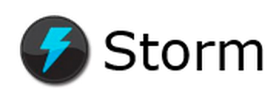
Couchbase Data Pipeline
All Data
Precompute Views (Map Reduce)
Batch Layer
Batch
Recompute
Couchbase Hadoop Connector (Sqoop)
Partial Aggregate
Partial Aggregate
Partial Aggregate
Serving Layer
New Data Stream
Batch Views
Merged View
Merge
Real-Time Views
Real-Time Data
Process
Stream
Incremental Views
Speed Layer
Real-Time
Increment
Notes:
- Improve the animation for data handling – refresh existing sales deck and deep dives.

Slide 15
Couchbase Data Pipeline
All Data
Precompute Views (Map Reduce)
Batch Layer
Batch
Recompute
Couchbase Hadoop Connector (Sqoop)
Partial Aggregate
Partial Aggregate
Partial Aggregate
Serving Layer
Stream / Data Ingestion
Store
Serving merged results / responses
New Data Stream
Batch Views
Merged View
Merge
Real-Time Views
Real-Time Data
Incremental Data / Stream processing
Process
Stream
Incremental Views
Speed Layer
Real-Time
Increment
Notes:
Using Couchbase as the high performance, low latency, scalable data store to support personalized interactions
Couchbase, as real-time operational database may be generating real-time data to feed into both the batch and real-time layers
In some use cases, Couchbase is used to perform real-time processing and analytics – M/R views
Some customers are using Couchbase as the data store to for stream processing
Email from Michael on streaming data from CB to Spark via Kafka:
well, Kafka is one way but it also uses DCP under the covers. I actually need to make some changes to the DCP implementation in the java client and my plan is to have DCP support in dp2 (a month later or so). So once we are GA, there will be a 100% way to stream data directly into a DStream (spark streaming).
And of course you can easily implement simple polling of let’s say a view, and grab the full docs that match for example a time interval.

Slide 16



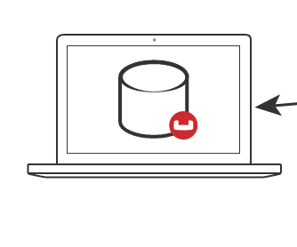
Couchbase Connectors
up to 10¹⁰ application users
10¹- 10²
data scientist / engineers
Spark
NoSQL Database
DCP
Kafka
Hadoop
Sqoop
XDCR
Storm
Elasticsearch
Notes:
Work people do in these systems -
Training ML models
ETL / Data wrangling
Aggregations
Reporting / BI
Kafka is a data multiplexer – some people are still going to want to do this, but it’s designed for higher latency applications with a known high complexity (e.g. ebay – many different consumers for information)
Traditional data warehouse – definitely will be a different programming language – how do you make sense of the data feed? You get into the problems that making changes on one side introduces tons of complexity on the other
Downsides – maturity is not 100% on the Spark side, still in active development in the Couchbase side
KV / N1QL

Slide 17










PERPETUAL
STORE
ANALYTICAL DB
BUSINESS INTELLIGENCE
MONITORING
BATCH TRACK
DASHBOARD
COMPLEX EVENT PROCESSING
Real Time REPOSITORY
CHAT/VOICE
SYSTEM
REAL-TIME TRACK
Notes:
The data generated by users is published to Apache Kafka.
Next, it’s pulled into Apache Storm for real time analysis and processing as well as into Hadoop.
Finally, Storm writes the data to Couchbase Server for real-time access by LivePerson agents while the data in Hadoop is eventually accessed via HP Vertica and MicroStrategy for offline business intelligence and analysis.

Slide 18



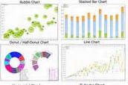
PayPal Use Case
http://developer.couchbase.com/documentation/server/4.1/connectors/kafka-2.0/kafka-intro.html https://github.com/paypal/couchbasekafka
DCP Stream
[1]
Couchbase Kafka Adapter
[2]
[3]
{DCP Client + Kafka Producer}
[6]
Camus ,
MR Jobs
[5]
[4]
[7]

Slide 19
Kafka Connector

Slide 20

Kafka
Publish-Subscriber System
Model which describes how Publishers can distribute information across multiple Subscribers those need to sign up for the retrieval of such data
Message Queue System
Messages are put (stored) in a queue until the recipient can retrieve them
Specifics
Commit log based
Distributed & partitioned
Failover mechanism

Slide 21
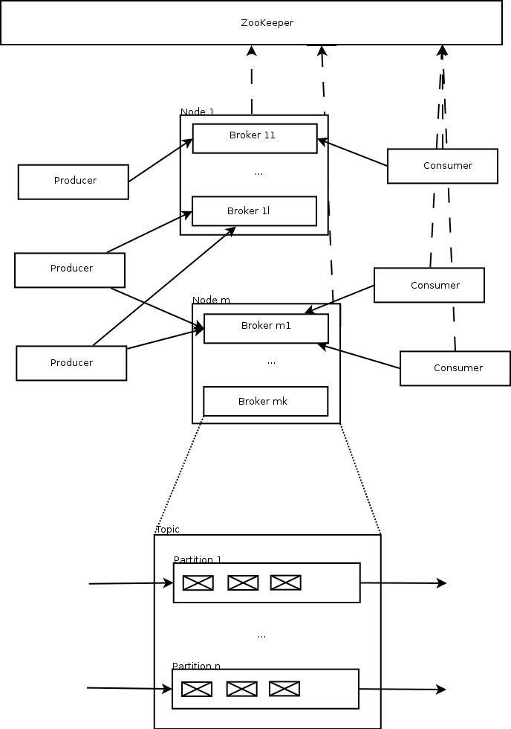
Kafka
ZooKeeper
Coordination between Kafka Brokers
Store Coordination Data, Status Information, Configurations
Broker
One or more Services those are processing messages
Can stores messages
Failover: Leader vs. Follower
Topic
Distributed/partitioned message queue
Consumer
Applications/processes/threads those are subscribed to the topic
Can be grouped in order to process messages in parallel
Producer
Publish data/messages to the topic

Slide 22
Kafka
Data broker w/ publish / subscribe system
Decouples producers of data from consumers
Massively scalable
Messages queued until the recipient can retrieve them
Consumer
Producer
Kafka
HDFS
Producer
Consumer
Producer
Producer
Consumer
Couchbase can be consumer and producer
Notes:
High throughput distributed messaging system
Massively scalable
Simple, elegant – basically a giant distributed ordered commit log
Like a manifold for your data processing – decouples the data producers from the data consumers, allows for asynchronicity
Automatic recovery from failures
Use cases: Offline & online processing of activities, events, monitoring, and sensor data
Couchbase can be either a producer or a consumer in Kafka terms.
Couchbase as the Master Database
React to changes happening in the bucket by updating data somewhere else
Triggers/Event Handling
Handle events like Deletions/Expirations externally (E.G. Expiration & replicated session tokens)
Real-time Data Integration
Extract from Couchbase , transform and load data in real time
Real-time Data Processing
Extract from a Bucket, process in real-time and load to another Bucket

Slide 23
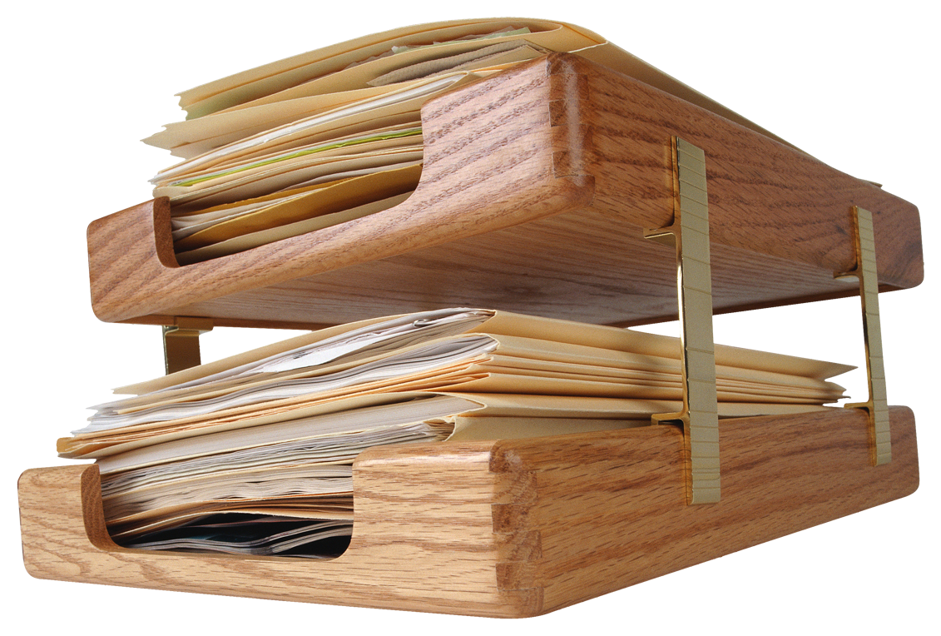
Couchbase/Kafka Use Cases
Polyglot Processing
Activities
Events
Monitoring Metrics
Sensor Data
Typical Use Cases
Messaging: Decouple data processing from data producers
Log Aggregation: A log as stream of messages
Stream Processing: Consume data from one topic and put the filtered/transformed data into another one
Click Stream Analysis: Page views/searches as real-time publish-subscribe feeds
Real-time Data Integration: Extract from Couchbase , transform and load data in real time

Slide 24
Couchbase Kafka Connector
Available Now: 2.0 GA
Kafka Producer or Consumer
Stream events
Filters
Transform events
Sample Producer & Consumer
Monthly Releases
Kafka Connect (Apache Kafka 0.9)
Merge code for Storm connector
???
Code: https://github.com/couchbase/couchbase-kafka-connector/
Issues: https://issues.couchbase.com/projects/KAFKAC
Docs: http://developer.couchbase.com/documentation/server/4.1/connectors/kafka-1.2/kafka-intro.html
Notes:
Fully transparent cluster and bucket management, including direct access if needed

Slide 25
Learn More - Couchbase Kafka Connector
Confluent’s Ewen Cheslack-Postava at Couchbase Connect 2015
https://youtu.be/fFPVwYKUTHs
Couchbase and Kafka - Up and Running in 10 Minutes
http://blog.couchbase.com/2015/november/kafka-and-couchbase-up-and-running-in-10-minutes
Product docs
http://developer.couchbase.com/documentation/server/4.1/connectors/kafka-1.2/kafka-intro.html
Avalon Consulting blog and Github repo
http://blogs.avalonconsult.com/blog/big-data/purchase-transaction-alerting-with-couchbase-and-kafka/
https://github.com/Avalon-Consulting-LLC/couchbase-kafka
Notes:
Fully transparent cluster and bucket management, including direct access if needed

Slide 26
Couchbase Spark Connector

Slide 27
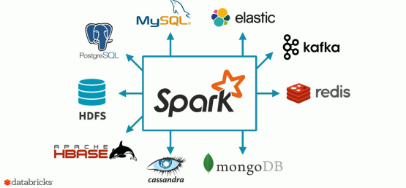


Spark
Source: Databricks https://www.brighttalk.com/webcast/12891/196891
DCP
KV
N1QL
Views

Slide 28
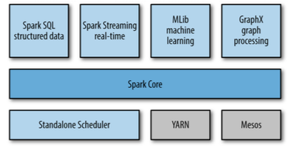
Spark
Fast and general engine for big data processing with libraries for advanced analytics
Spark Core:
task scheduling
memory management
fault recovery
interacting with storage systems
Notes:
Spark Core
Automatic Cluster and Resource Management
Creating and Persisting RDDs
Java, Scala APIs
Spark SQL
Easy JSON handling and querying
Tight N1QL Integration
Spark Streaming
Persisting DStreams
DCP source (experimental)

Slide 29
Spark
Resilient Distributed Dataset: Core Spark data abstraction
Distributed collection of elements
Read-only (immutable)
Fault tolerant: Can recover from loss of a partition
Re-computed, not stored
Operations
Transformation: Lazy operation creating new RDD
e.g. map(), filter()
Action: Return a result or save it
e.g. take(), save()
Notes:
(1) The main challenge in designing RDDs is defining a programming interface that can provide fault tolerance efficiently. Existing abstractions for in-memory storage on clusters, such as distributed shared memory, keyvalue stores, databases offer an interface based on fine-grained updates to mutable state (e.g., cells in a table). With this interface, the only ways to provide fault tolerance are to replicate the data across machines or to log updates across machines. Both approaches are expensive for data-intensive workloads, as they require copying large amounts of data over the cluster network, whose bandwidth is far lower than that of RAM, and they incur substantial storage overhead.
In contrast to these systems, RDDs provide an interface based on coarse-grained transformations (e.g., map, filter and join) that apply the same operation to many data items. This allows them to efficiently provide fault tolerance by logging the transformations used to build a dataset (its lineage) rather than the actual data.1 If a partition of an RDD is lost, the RDD has enough information about how it was derived from other RDDs to recompute just that partition. Thus, lost data can be recovered, often quite quickly, without requiring costly replication.
[Matei Zaharia, et. al, Resilient Distributed Datasets: A Fault-Tolerant Abstraction for In-Memory Cluster Computing, at: https://www.cs.berkeley.edu/~matei/papers/2012/nsdi_spark.pdf]
Session 3: RDDs and Spark Architecture

Slide 30
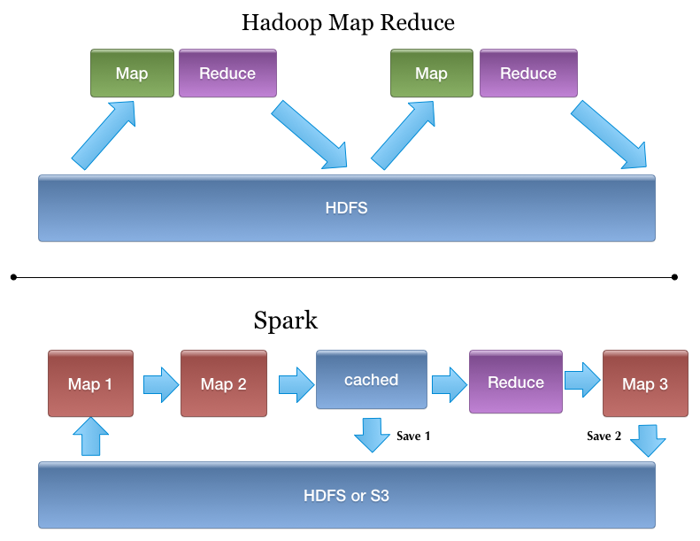
Spark
RDD is created by either:
Loading an external dataset or RDD
RDD is transformed:
Result: A new RDD
Sequence of transformations
Data is eventually extracted
By an action on an RDD
Reduce disk dependency
Create: Read a log file sc.textFile(“server.log”)
Filter: Keep lines starting with "ERROR"
Filter: Keep lines containing ”system5"
Action: Write result to storage
Notes:
Session 2: Introduction to Spark

Slide 31
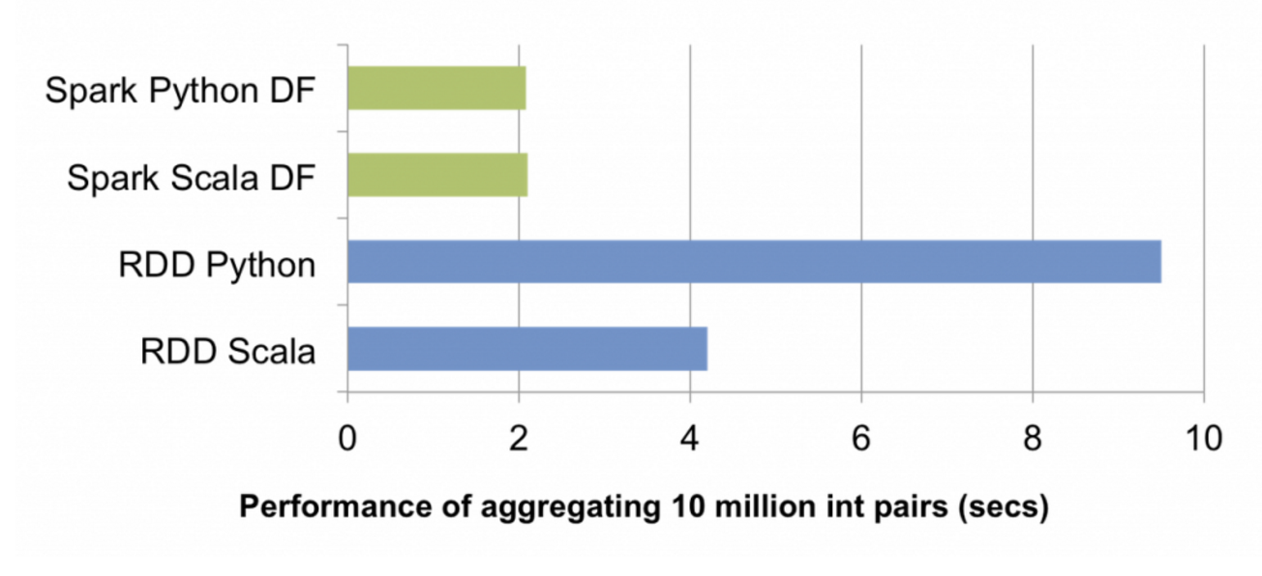
DataFrames (SparkSQL)
Distributed collection of data organized in named colums
DataFrame = “RDD + Schema”
Perform SQL Queries on top of your data
From https://databricks.com/blog/2015/02/17/introducing-dataframes-in-spark-for-large-scale-data-science.html

Slide 32
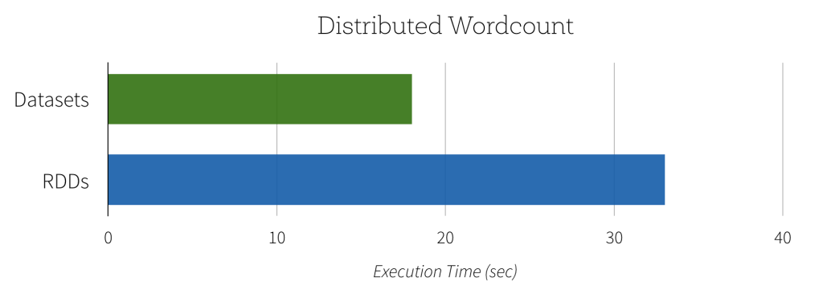
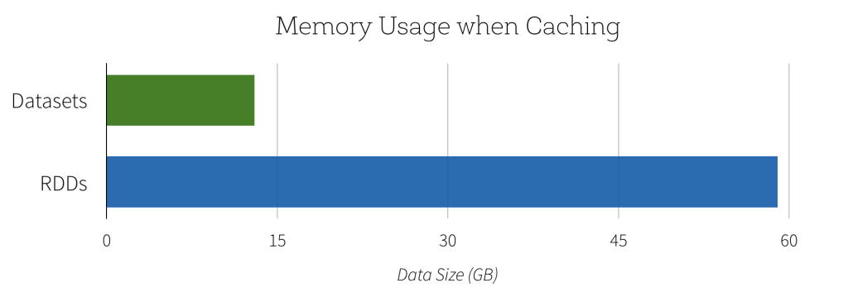
Datasets
Typesafe programming on top of DataFrames
Initial support in Spark 1.6, likely to be extended in 2.0
Higher performance & less memory usage
Encoding/Decoding for semi-structured data
https://databricks.com/blog/2016/01/04/introducing-apache-spark-datasets.html

Slide 33
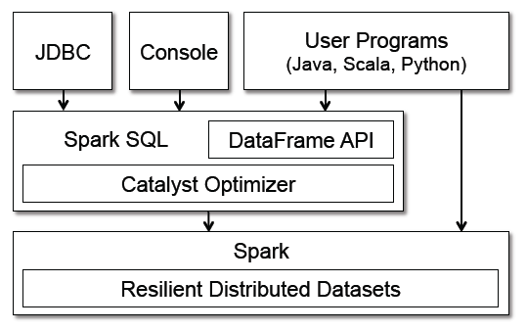
Spark SQL within Spark
Runs as Library over Spark
Exposed to Spark via DataFrame API
Notes:
Image from "Spark SQL: Relational Data Processing in Spark" by Michael Armbrust, et. al
Session 6: Spark SQL

Slide 34
Couchbase Spark Connector
application users
data scientists &
data engineers
DCP
Features
Create RDDs from KV, N1QL, Views
Create DStreams from DCP feeds
Persist RDDs and Dstreams
Support for DataFrames and SparkSQL
Notes:
Analyze other

Slide 35
Couchbase Spark Use Case: Data Analysis
Query across data in many systems using one language & runtime
Separate Couchbase clusters for workload isolation
Results streamed back as needed to support applications
Operational
Data Store
XDCR
hdfs
s3
RDBMS
Elastic

Slide 36
Couchbase Spark Use Case: Machine Learning
Data scientists train machine learning models
Load results into Couchbase so end users can interact with them online
Recommendations for content and products, fraud detection or spam filter
DCP
Machine Learning Models
Data Warehouse
Hadoop
Historical Data
Notes:
Analyze other

Slide 37
Couchbase Spark Connector 1.2
Upcoming Release (planned) : 1.2
Spark 1.6 Support (including Datasets)
Bugfixes
Enhanced Java APIs
Updated DCP Functionality
github.com/couchbaselabs/couchbase-spark-connector
https://issues.couchbase.com/projects/SPARKC
Notes:
Fully transparent cluster and bucket management, including direct access if needed

Slide 38
Learn More - Couchbase Spark Connector
Github Repo
https://github.com/couchbaselabs/couchbase-spark-connector
Spark with Couchbase to Electrify your Data Processing
https://youtu.be/sBnAf7gAfLc
Docs
http://developer.couchbase.com/documentation/server/current/connectors/spark-1.0/spark-intro.html
Avalon Consulting blog and Github repo (Market Basket Analysis)
http://blogs.avalonconsult.com/blog/big-data/combining-operational-and-analytical-big-data-using-couchbase-and-spark-a-market-basket-analysis-example/
https://github.com/Avalon-Consulting-LLC/couchbase-spark-mba
Notes:
Fully transparent cluster and bucket management, including direct access if needed

Slide 39
Q&A
justin@couchbase.com

Slide 40
Dev Guide

Slide 41
Anatomy of a Spark Application
Driver Program
Cluster Manager
SparkContext
Spark Worker
Data Node
Data Node
Executor
Task
Couchbase
Couchbase
Couchbase
Notes:
Spark Application = a user program built on Spark. It includes the driver program and the executors on the cluster.
Application jar – a jar containing the users application along with its dependencies.
Driver program – The process running the main() function of the application and creating the SparkContext
Executor - A process launched for an application on a worker node, that runs tasks and keeps data in memory or disk storage across them. Each application has its own executors.

Slide 42
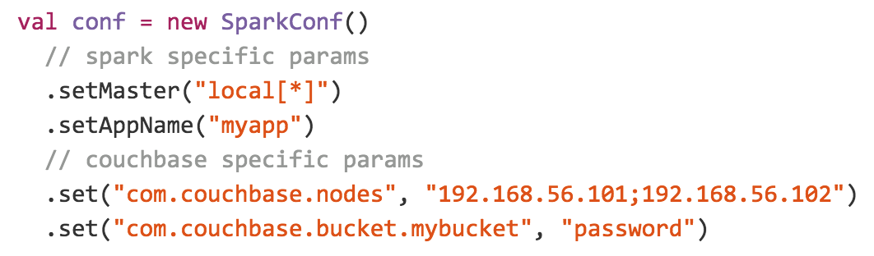
Connection Management

Slide 43
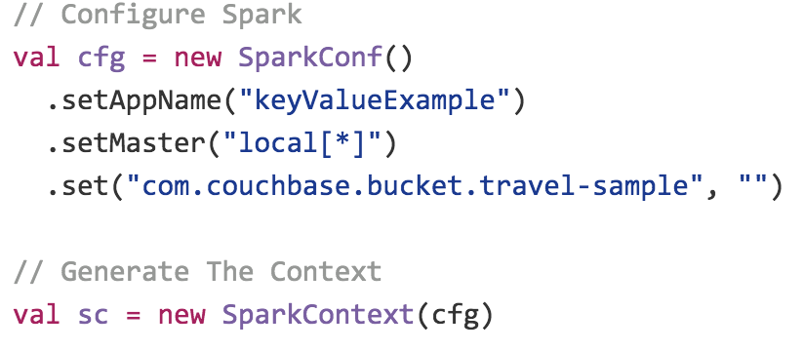
Connection Management

Slide 44
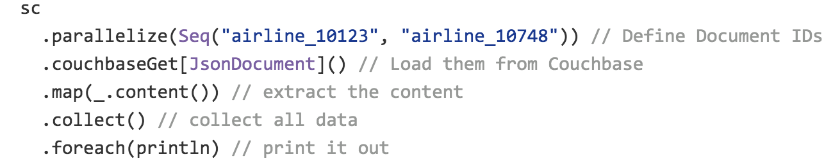
Creating RDDs

Slide 45
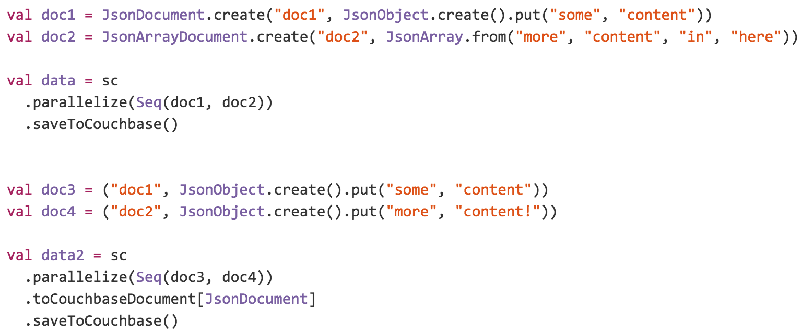
Persisting RDDs

Slide 46
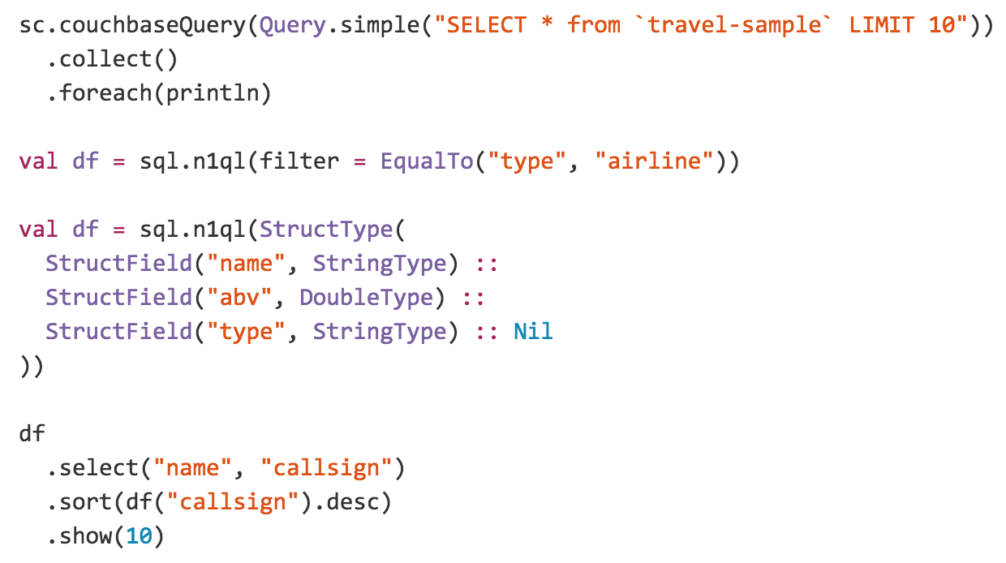
RDD N1QL Query

Slide 47
Spark SQL - Schema

Slide 48
Spark SQL – Dataframe Query

Slide 49
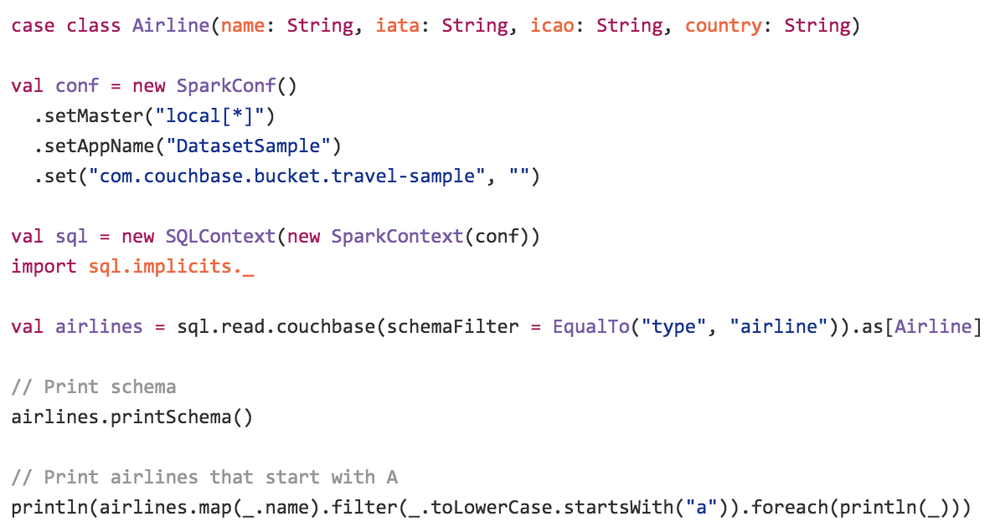
Demo of Dataset (Spark 1.6)

Slide 50
Demo of Dataset (Spark 1.6)

Slide 51
Demo of Dataset (Spark 1.6)

Slide 52
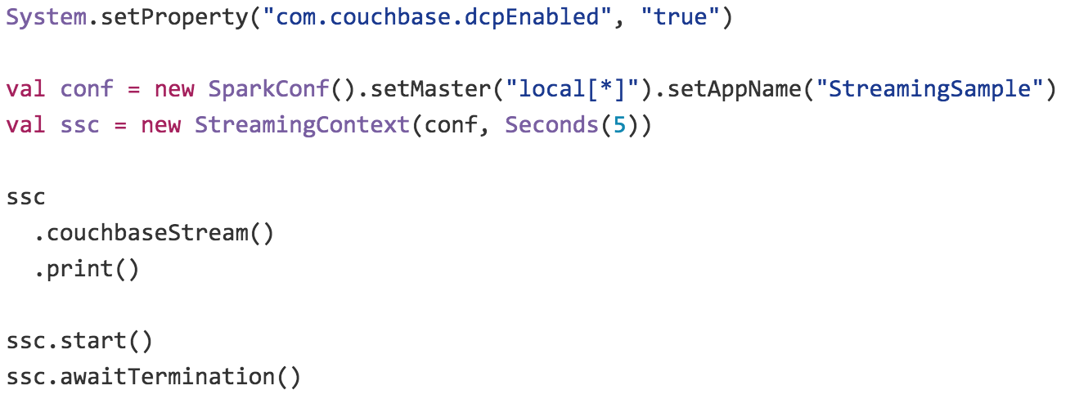
Spark Streaming with DCP

